Slide 1
Fundamentals of Cryptography Security Attacks
Brajesh Kumar Sharma
Asst. Professor(CSE)
SPSU, Udaipur

Slide 2
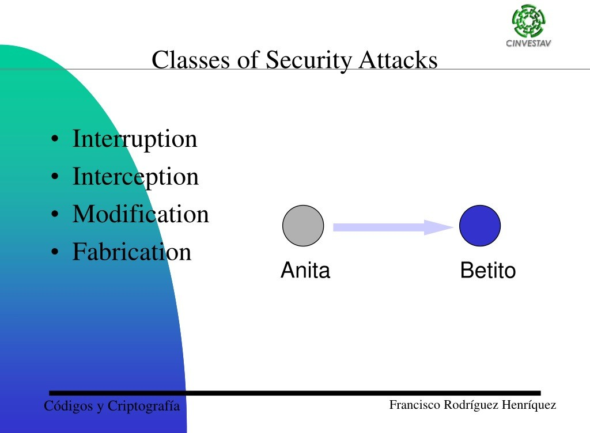

Slide 3
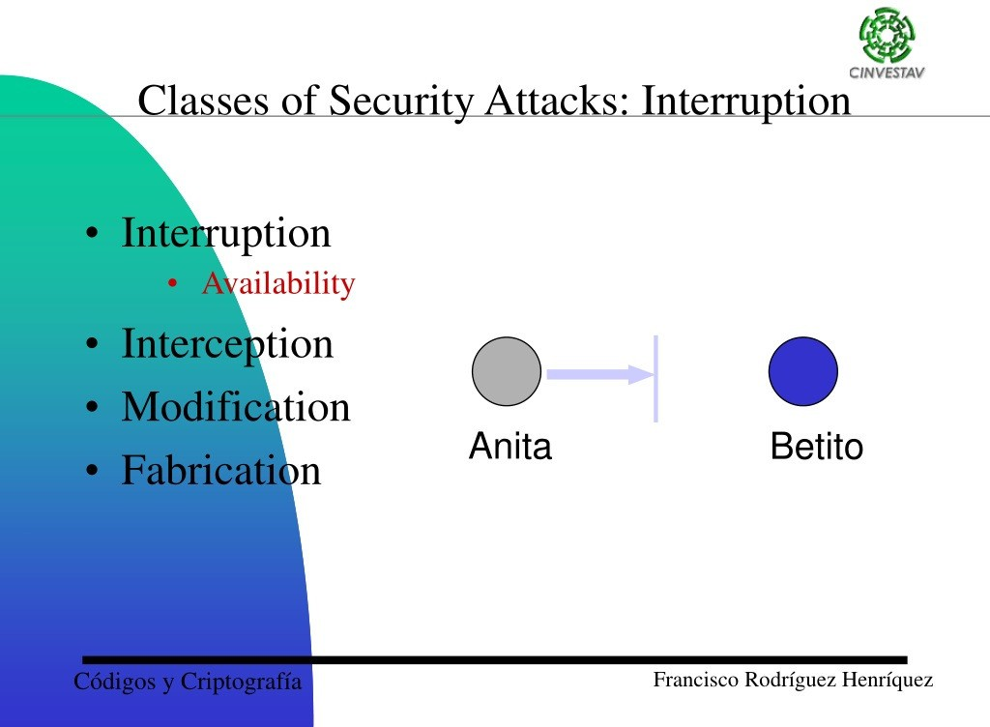

Slide 4
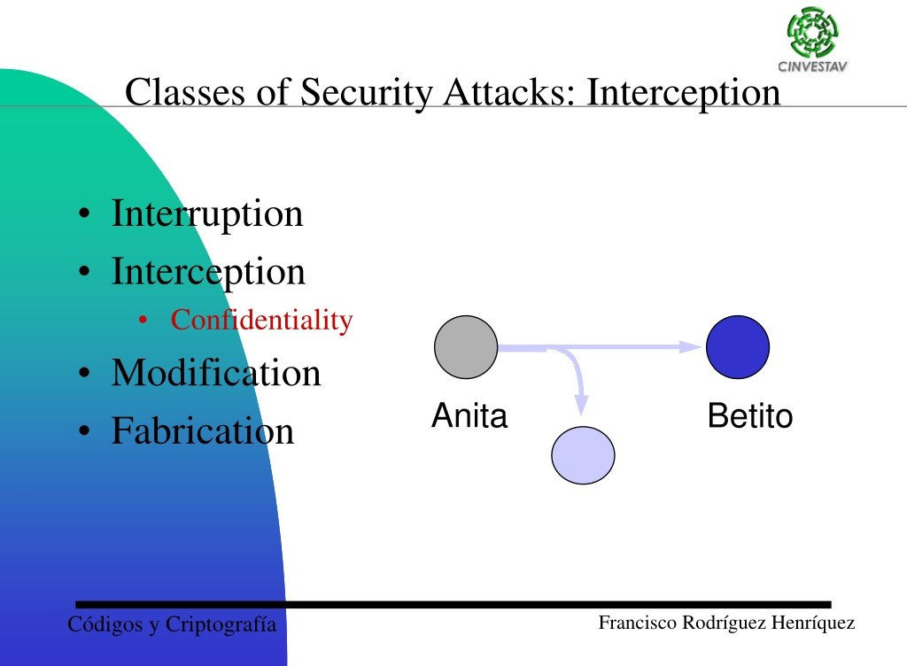

Slide 5
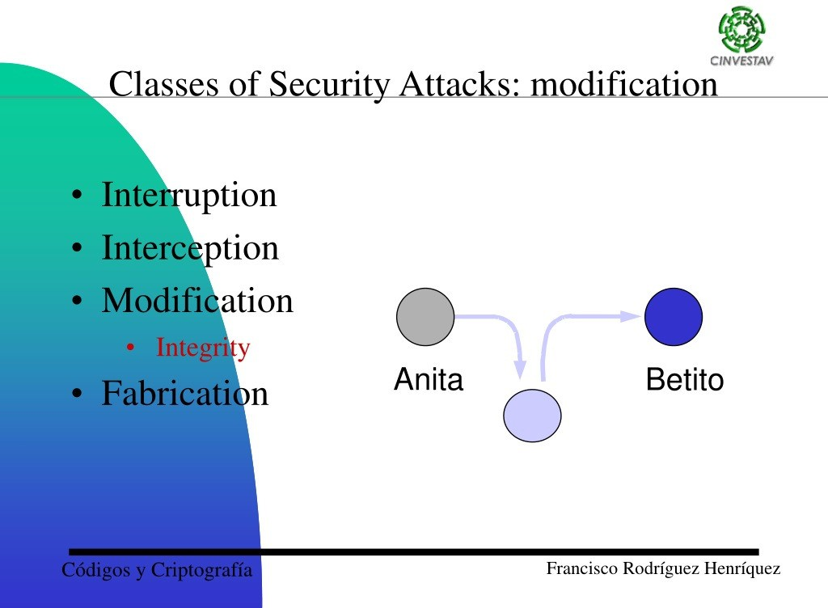

Slide 6
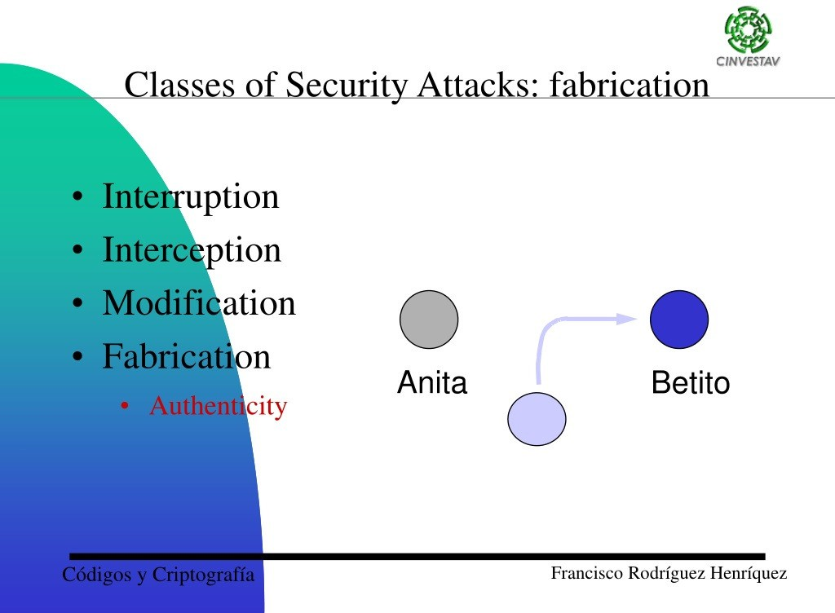

Slide 7
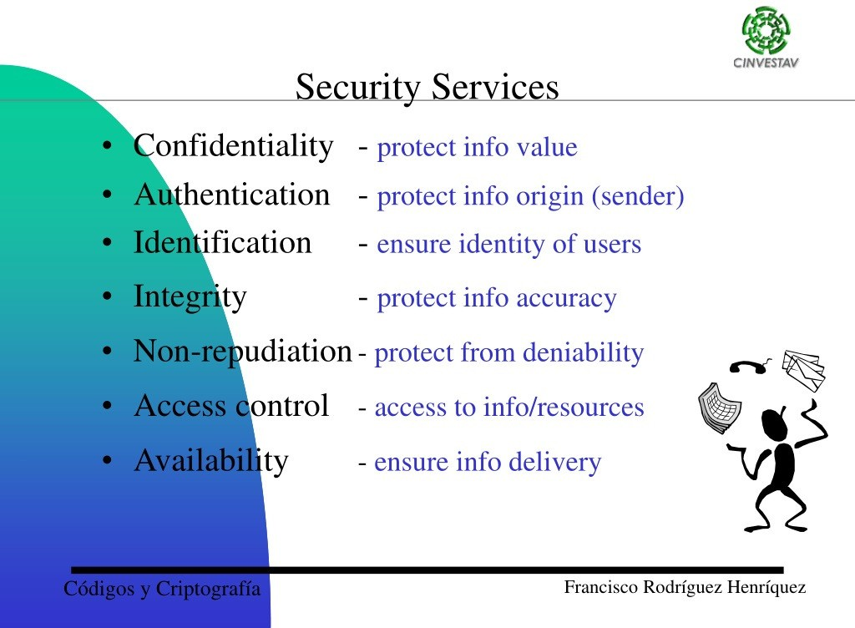

Slide 8
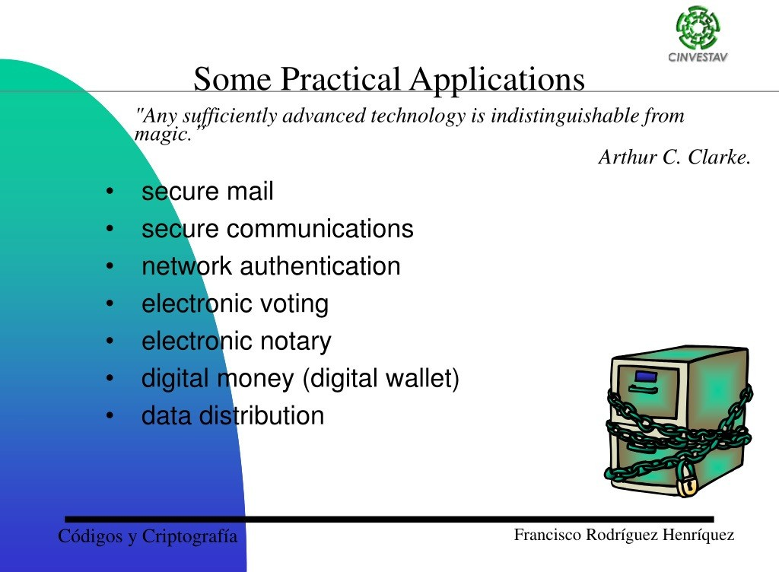

Slide 9
